Slide 1

Machine Learning & Content Analytics
Short Term Electrical Load Forecasting
Manos Pratikakis
Giorgos Dimopoulos
ATHENS UNIVERSITY OF ECONOMICS AND BUSINESS

Slide 2
Contents
Problem Definition
1
Dataset Description
2
Model Results
3
Business Goals
Problem Modeling
Assessment

Slide 3
Problem Definition
Importance
Complexity
Electrical Load Forecasting is the estimation of future load values. Short-term refers to the estimation of load values for the day ahead.
Methods
Electrical energy is generated according to the demand.
Load forecasting is used to estimate the amount of power needed to supply the demand.
Calculate imbalances, estimate expenditures, load nomination.
Different categories of load (domestic, commercial, industrial) with unique characteristics.
Load timeseries exhibits several levels of seasonality (weekly, daily, yearly).
Exogenous variables that should be considered e.g. weather.
Similar Day Approach
Regression Models
Time Series Analysis
Machine Learning Algorithms
Artificial Neural Networks

Slide 4
Business Goals
Hourly load predictions for the day ahead.
Capture the complex seasonality patterns and exogenous variables relationships such as weather information.
Model should be able to readjust to exogenous factors affecting load consumption such as generation capacity increase/decrease or consumer portfolio changes.
Execution time and data availability must also be considered since we need forecasts for the short-term (e.g. next few hours).

Slide 5
Dataset Description
Sources
Data Volume
Exploration
Transformation to timeseries format
Load consumption data in combination with weather data (Temperature, Humidity, Wind) from Athens and Thessaloniki.
Dates:
1 June 2018 - 30 June 2021
Frequency:
Hourly values – electric load
Half hourly values - weather
Drop duplicate dates
Forward fill the missing hours
Remove percentage (‘%’), Celsius (‘°C’) and the Beaufort (‘Bf’) symbols
Load consumption: publicly available from the ENTSO-E
Weather data: scrapped from free meteo website
Merge weather data and electric load in same granularity tabular format for all dates
Create two more variables:
Month of the year
Flags the national holidays and weekends.
Datasets sources: https://transparency.entsoe.eu/
https://freemeteo.gr/

Slide 6
Final dataset
 | Load | Temperature Athens | Wind Athens | Humidity Athens | Temperature Thessaloniki | Wind Thessaloniki | Humidity Thessaloniki | Month | Holiday/ Weekend
Date
2018-06-01 00:00:00 | 5047 | 21.5 | 2.5 | 30.0 | 19.0 | 1.0 | 66.0 | 6 | 1
2018-06-01 01:00:00 | 4696 | 20.0 | 2.0 | 33.0 | 19.0 | 1.0 | 68.0 | 6 | 1
2018-06-01 02:00:00 | 4560 | 19.0 | 2.0 | 36.0 | 19.0 | 1.0 | 64.0 | 6 | 1
2018-06-01 03:00:00 | 4482 | 21.0 | 2.5 | 32.0 | 17.0 | 1.5 | 73.0 | 6 | 1
2018-06-01 04:00:00 | 4465 | 20.5 | 1.0 | 34.0 | 16.5 | 1.5 | 75.0 | 6 | 1
… | … | … | … | … | … | … | … | … | …
Last step:
Scale data to [0,1] range
speeds up learning
leads to faster convergence

Slide 7
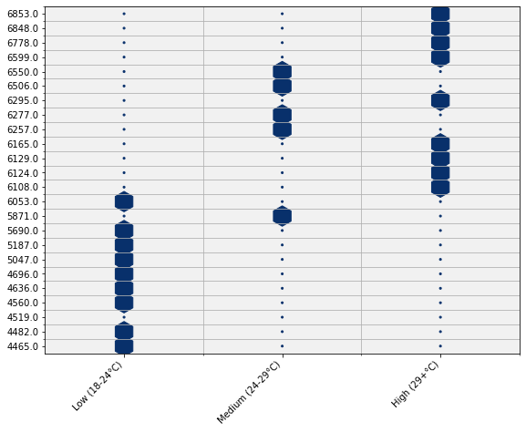
Exploratory data analysis
Electric load consumption vs Temperature of Athens
Negative linear association up to ~20 °C
Positive up until 40+ °C
Day: 1 June 2018 - Positive association
Temperature separated in three different bins

Slide 8
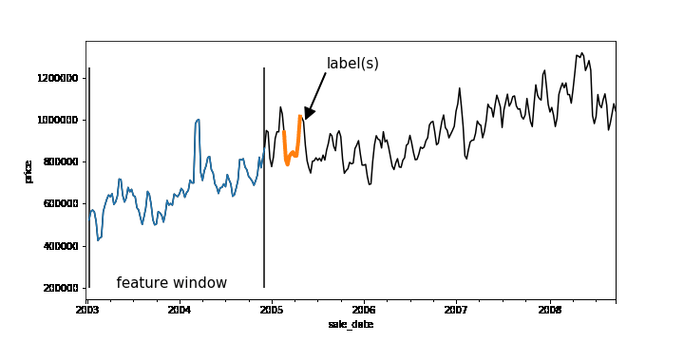
Sliding Window Mechanism
Sliding window is used to transform the tabular time series data set to a proper format for a supervised learning problem.
This mechanism allows us to model a forecasting problem as a supervised learning problem, where the data should be in [observations, input features] , [observations, output features].
Each sample in the transformed dataset holds historical data of a specific input window size.
The output or target variable in the transformed dataset are the future values of the corresponding input features.
Each sample differs from the previous one by a defined interval e.g. 1h, 24h etc.

Slide 9
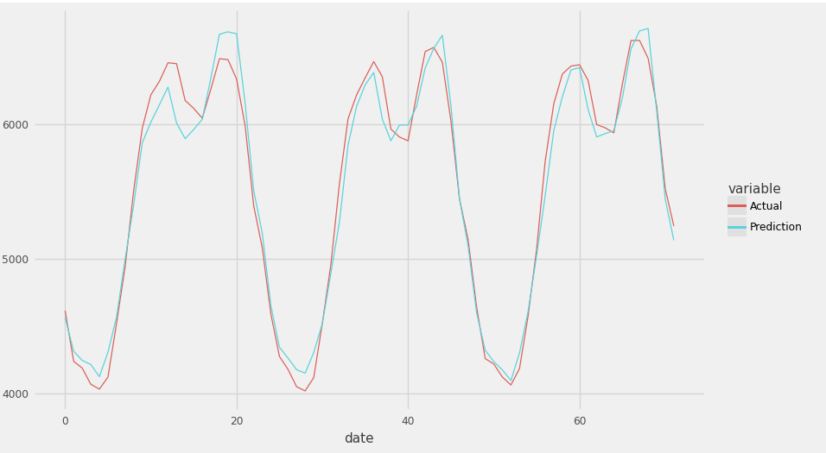
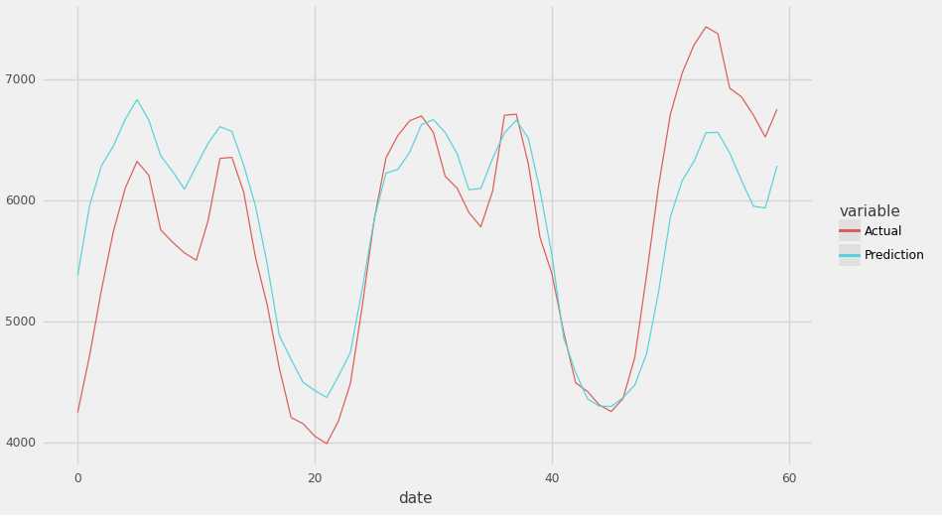
Feed Forward Models
Actual vs Predicted electric load on random hours
Two models tried from this category, both with sliding window size 1
1st: Uses the 24 past hours as input, while the output length is 1h ahead
2nd: Instead of predicting for the next 1 hour it predicts a single load value that is 48h ahead of the corresponding input values
Sigmoid activation function in the last layer and the relu activation functions in other layers
Train Score: 240.16 RMSE
Test Score: 256.00 RMSE
1st :
Benefits | Drawbacks
Fast | Does not cover business needs (Predicts 1 h ahead)
Relatively low Complexity | Second model is not able to estimate all the peaks
Train Score: 546.12 RMSE
Test Score: 565.41 RMSE
2nd :

Slide 10
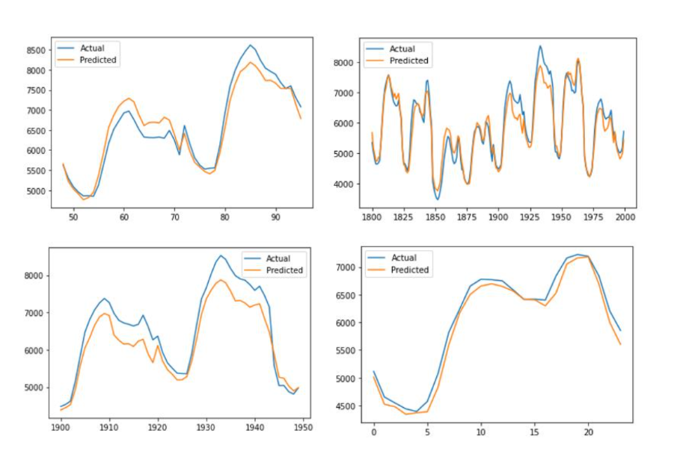
RNN/ LSTM/ GRU Models
Can handle sequential data better, consider not only the current input but also the previously received inputs.
LSTM & GRU layers , a special type of RNN that can learn long-term dependencies.
Data input to model are now given in [samples, timesteps, features] format.
Experimented with different architectures, neurons, layers, input size windows, train and test sets, trying all possible combinations of these parameters.
Results from an LSTM model with sliding window size 24, that uses the past 72h to predict the next 24.
Benefits | Drawbacks
Captures load seasonality and certain peaks. | Higher complexity, increased time to train and predict.
Single prediction for the day ahead (24 load values).
Better exploits the exogenous variables relationships and their seasonality.

Slide 11

Selected Final Model
Configuration
Business Needs Covered
A single prediction of the model outputs 24h future load values.
The model is able to capture the multiple seasonalities (daily, weekly, monthly) and also exploit the weather and calendar information.
Can be retrained when the most up to date data become available.
There is an issue of data availability, since the model requires the exact previous 48 load values to predict the next day.
2 LSTM layers with 100 neurons each using Relu activation, and a Dense layer with 24 neurons using the sigmoid activation, as the output layer.
Sliding Window of size 1 to make better use of all available data.
Input Features size set to past 48h.
Used Early Stopping and Dropout to prevent overfitting.
Trained and tested on different samples to get a better understanding of model’s performance

Slide 12
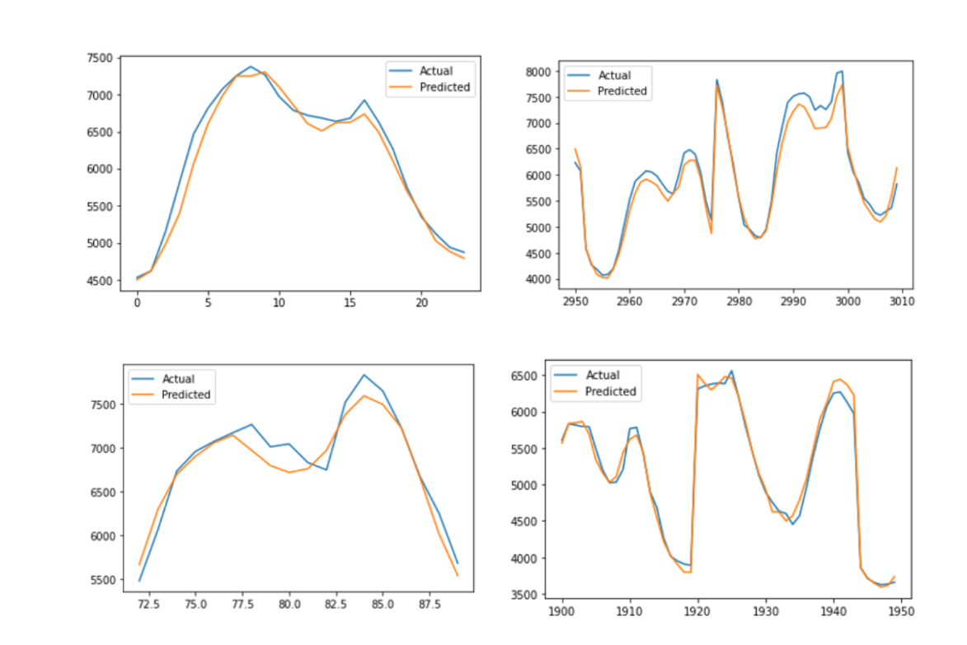
Final Model Predictions Accuracy
Root Mean Squared Error during training : 227.42 RMSE
Root Mean Squared Error during testing : 234.36 RMSE
Mean Absolute Error : 184.47 MAE
Mean Absolute Percentage Error : 3.21 %

Slide 13
Key Takeaways
After experimenting with different methodologies and data flow mechanisms, we ended up with a model that can forecast up to 24h of future electrical load.
The model can capture the relationship of electrical load and exogenous variables such as weather and calendar data.
LSTM layers appear to have better performance in terms of predictive accuracy compared to Feed Forward models.
Future work of this project may include experimenting different data flow mechanisms like sliding window or trying additional exogenous variables.
While modeling the Short-Term forecasting as a Supervised Learning Problem allows for introducing new methodologies and algorithms, attention should be also given to the data “needs” of the model and the availability.
Despite the execution time or complexity, artificial neural networks can adequately solve the Short-Term Forecasting problem and can be utilized by power utilities companies and electricity industry.

Slide 14
Thanks!

